Slide 1
SNAP-1
Research and Audit for Quality Improvement Day
RCoA
Friday February 28th 2014
Ellie Walker (Trainee Lead SNAP-1)

Slide 2
SNAP-1
Background
SNAP-1
Key dates
Data to be collected
Preparation for project at local sites
Patient recruitment
Data entry
Data analysis

Slide 3
Sprint National Anaesthesia Projects (SNAPs)
‘Snapshot’ of clinical activity across the UK
Area of interest to patients and anaesthetists
Annual
Quality improvement model
QuARCs

Slide 4
Trainee-led research groups

Slide 5
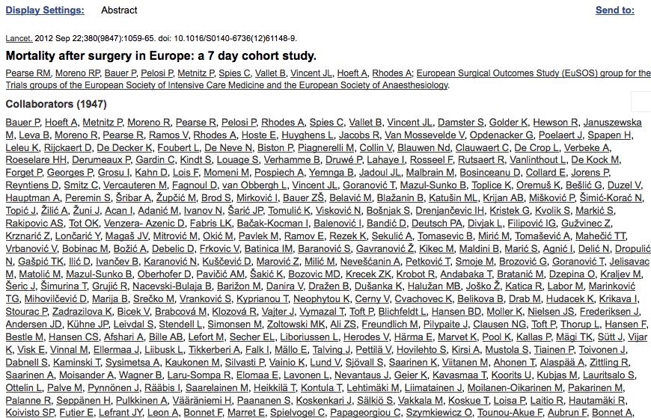
Collaborators

Slide 6
SNAP-1
Tuesday 13th and Wednesday 14th May 2014
Patient reported outcome after anaesthesia:
Patient satisfaction
Patient reported awareness
2 questionnaires and demographic / perioperative data
Patients > 18 years old undergoing non-obstetric procedure in an operating theatre.

Slide 7
SNAP-1
Every hospital with an anaesthetic department can take part.
Deadline for hospitals/Local Lead Investigators (LLIs) to register - Monday 17th March.
Registration closes for Local Investigators (LIs - trainees and consultants) - Friday 25th April.
Fortnightly updates of hospitals with LLIs/LIs will be provided.
Ensure every hospital has LLI and appropriate numbers of LIs.

Slide 8
Patient satisfaction
Bauer patient satisfaction questionnaire
Single centre pilot study
National benchmark

Slide 9
Bauer questionnaire
Date of completion: (tick-box)
At any stage after your operation have you had the following:
Anaesthesia-related discomfort: No Yes, moderate Yes, severe
Drowsiness
Pain at the site of surgery
Thirst
Hoarseness
Sore throat
Nausea or vomiting
Feeling cold
Confusion or disorientation
Pain at the site of the anaesthetic injection
Shivering

Slide 10
Bauer questionnaire
Satisfaction with anaesthesia care:
Four point Likert scale:
Very satisfied Satisfied Dissatisfied Very dissatisfied
How satisfied were you with the information you were given by the anaesthesist before the operation?
How satisfied were you waking up from anaesthesia?
How satisfied have you been with pain therapy after surgery?
How satisfied were you with treatment of nausea and vomiting after the operation?
How satisfied were you with the care provided by the department of anaesthesia in general?
Would you recommend this department of anaesthesia to your friends and family? Yes / No

Slide 11
Modified Brice questionnaire

Slide 12
Brice questionnaire
Were you expecting to have a general anaesthetic (i.e. be completely asleep) for this operation (please circle)? YES / NO
1. What is the last thing you remember before going to sleep (please tick one box)?
-Being in the pre-operative area ☐ -Seeing the operating room ☐
-Being with family ☐ -Hearing voices ☐
-Feeling mask on face ☐ -Smell of gas ☐
-Burning or stinging in the IV line ☐ -Not applicable ☐
-Other [Please write below]:

Slide 13
Brice questionnaire
2. What is the first thing you remember after waking up (please tick one box)?
-Hearing voices ☐ -Feeling breathing tube ☐
-Feeling mask on face ☐ -Feeling pain ☐
-Seeing the operating room ☐ -Being in the recovery room ☐
-Being with family ☐ -Being in intensive care unit ☐
-Nothing ☐ -Not applicable ☐
-Other [Please write below]:

Slide 14
Brice questionnaire
3. Do you remember anything between going to sleep and waking up (please tick box)?
-No ☐
-Yes:-Hearing voices ☐ -Hearing events of the surgery☐
-Unable to move or breathe ☐ -Anxiety/stress ☐
-Feeling pain ☐ -Sensation of breathing tube ☐
-Feeling surgery without pain☐ -Not applicable ☐
-Other [Please write below]

Slide 15
Brice questionnaire
4. Did you dream during your procedure (please tick box)?
-No ☐ -Yes ☐
-What about [Please write below]:
5. Were your dreams disturbing to you (please tick box)?
-No ☐ -Yes ☐
6. What was the worst thing about your operation (please tick box)?
-Anxiety ☐ -Pain ☐ -Recovery process ☐ -Awareness ☐
-Unable to carry out usual activities ☐
-Other [Please write below]:

Slide 16
Patient demographics
Completed by anaesthetist at time of surgery:
Patient name and hospital identifier:
1. Sex: Male ☐ Female ☐
2. Patient age:
3. Date of operation: 13/05/14 ☐ 14/05/14 ☐
4. Operation name:
5. ASA grade: 1☐ 2 ☐ 3 ☐ 4 ☐ 5 ☐
6. Surgical urgency: Elective ☐ Expedited ☐
Urgent ☐ Immediate ☐
Notes:
Subject to change

Slide 17
Patient co-morbidities
7. Active cancer: Yes ☐ No ☐
8. Congestive heart failure: Yes ☐ No ☐
9. History of previous CVA/TIA: Yes ☐ No ☐
10. Is the patient on long-term analgesic/BDZ medications:
Opiates / Opioids: Yes ☐ No ☐
NSAIDs: Yes ☐ No ☐
Neuropathic pain medications: Yes ☐ No ☐
BDZ Yes ☐ No ☐
Other (please specify):
Notes:
Subject to change

Slide 18
Perioperative
11. Analgesia / Anaesthesia:
GA: Yes ☐ No ☐
Epidural: Yes ☐ No ☐
Spinal: Yes ☐ No ☐
Combined spinal and epidural: Yes ☐ No ☐
Sedation: Yes ☐ No ☐
Peripheral nerve block: Yes ☐ No ☐
Transverse Abdominus Planus block: Yes ☐ No ☐
Surgical infiltration with LA: Yes ☐ No ☐
Notes:
Subject to change

Slide 19
Perioperative/Postoperative
12. Other:
Anti-emetic given: Yes ☐ No ☐
Steroid anti-emetic given: Yes ☐ No ☐
TIVA: Yes ☐ No ☐
Inhalational anaesthetic: Yes ☐ No ☐
BIS / E - Entropy / Narcotrend used: Yes ☐ No ☐
13. Postoperative destination / level of care:
Home (day case) ☐ Inpatient ward ☐
High Dependency Unit (Level 2) ☐ Intensive Care Unit (Level 3) ☐
Notes:
Subject to change

Slide 20
SNAP-1
LLI to provide summary CV and signed SSI form by Friday 28th March for local R&D sign off.
Final list of LIs will be sent to LLIs week beginning 28th April.
All LLIs/LIs named as collaborators.
Regional trainee-led networks recognised.
LLI responsible for ensuring all registered LIs take an active role.

Slide 21
SNAP-1 preparation
Advertise SNAP-1 in your department.
All anaesthetists will be asked to complete perioperative information on Tuesday May 13th and Wednesday May 14th.
Further information regarding the project and (draft) versions of each of the questionnaires are on the SNAP-1 website: http://www.niaa-hsrc.org.uk/SNAPs
Notes:
Those covering the ‘emergency theatres’ may also be asked to distribute patient information sheets to eligible ‘non elective’ patients when they are undertaking the preoperative assessment of these patients over the 2 day period.

Slide 22
SNAP-1 patient recruitment
Under supervision of LLI, LIs responsible for data collection.
Administration of questionnaires to consenting patients within 24 hours of their operation.
Number of LIs required at each site will vary.
Suggest that LIs are not allocated other clinical responsibilities on the study days.

Slide 23
SNAP-1 patient recruitment
Distribution of patient information sheets to all eligible patients on Tuesday 13th and Wednesday 14th May.
If numbers allow, separate LIs responsible for ensuring perioperative information is completed at time of surgery.
Engagement of staff in ‘Day-case unit’.
In-patients visited later the same day or first thing the following morning.
Completed questionnaires stored in secure location.
Notes:
Each potential participant should be provided with a patient information leaflet on admission to hospital, prior to their surgery, so that they have time to consider the information provided. If they agree to complete and return the questionnaires, this will be taken as implied consent to participate.
After completion of the surgery and full recovery from anaesthesia, patients should be approached by LIs or nominated representatives to complete the two paper based questionnaires and told that this should take no more than 10 minutes in total.
Patients undergoing day-case procedures will be asked to complete the questionnaires before they are discharged home on the day of their surgery and those who remain as in-patients in hospital should be approached within 24 hours of their operation once they are on a ward.
The date of completion of the questionnaires will be recorded on the forms themselves.
If patients need help understanding the questionnaire or physically filling it in, a LI should be available to help them do so.

Slide 24
SNAP-1 data entry
All registered LLIs/LIs provided with login details.
Online data entry available from Tuesday May 13th until week ending Friday May 30th.
Ability to export local data.
Web tool reopened after end of project.
IT support provided by Netsolving throughout the project.

Slide 25
SNAP-1 data entry
Each patient entry will generate a unique identifier.
LLIs/LIs to keep a secure log of these unique identifiers linked to hospital identification numbers.
No patient identifiable data to be transferred outwith the local site.

Slide 26
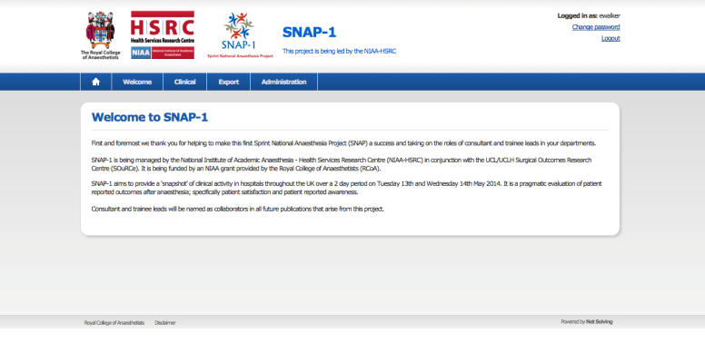
SNAP-1 web tool
SNAP-1 data collection web tool

Slide 27
SNAP-1 web tool

Slide 28
SNAP-1 web tool

Slide 29
Data analysis
Bauer patient satisfaction questionnaires:
Type of surgery and anaesthetic.
Overall picture of satisfaction after specific procedures and following different types of anaesthesia.
Results reported at national level.
Brice questionnaire:
Determine the incidence of suspected awareness under anaesthesia nationally.
Potential cases referred to expert panel.
LLIs contacted if awareness suspected.
Follow-up according to local departmental guidelines.

Slide 30
SNAP-1 quick guide timeline
Week beginning Monday 10th February 2014
Registration open for trainee and consultant investigators
Friday 28th February 2014
Research and Audit for Quality Improvement Day at RCoA
Friday 28th March 2014
Deadline for submission of signed SSI form and CV by LLIs
Friday 25th April 2014
Registration window closes for trainee and consultant local investigators
Tuesday 13th, Wednesday 14th and Thursday 15th May 2014
SNAP-1 data collection study days
Week ending 30th May 2014
Closure of data collection web tool
Monday 17th March 2014
Deadline for hospitals/LLIs to register to participate

Slide 31
Further information
Website: http://www.niaa-hsrc.org.uk/SNAPs
Email: snap1@rcoa.ac.uk
Twitter: @anaesthesiaSNAP
Thank you very much for helping to make SNAP-1 a success!

